Slide 1





Department of computer science and mathematics
Master of artificial intelligence and distributed systems
Data Structures and algorithmics in python
From Theory to Practice:
“Implementing a queue in python using lists”
Academic year : 2024/2025

Slide 2
Table of Contents
Introduction
1st Implementation
4
Oriented Object Programming
2nd Implementation
1
5
Data Structures and python
Queues and AI/DS
2
6
FIFO Concept and Queues
Conclusion
3

Slide 3
Introduction

Slide 4






E
Object Oriented programming?
Class: Animal
Classes:
dog
cat
elephant
Objects:
myDog
myCat
myElephant

Slide 5

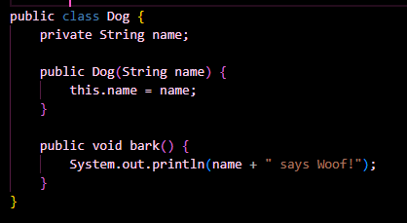
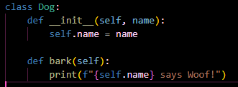
Object Oriented programming:
Java
Python
Java
Python
Syntax and Verbosity

Slide 6
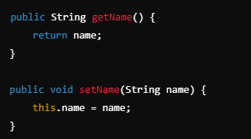
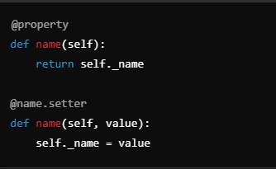
Access Modifiers
Properties and Getters/Setters
Java
Inheritance
class ChildClass(ParentClass)
Constructors and Destructors
Interfaces and Abstract Classes
Python

Slide 7
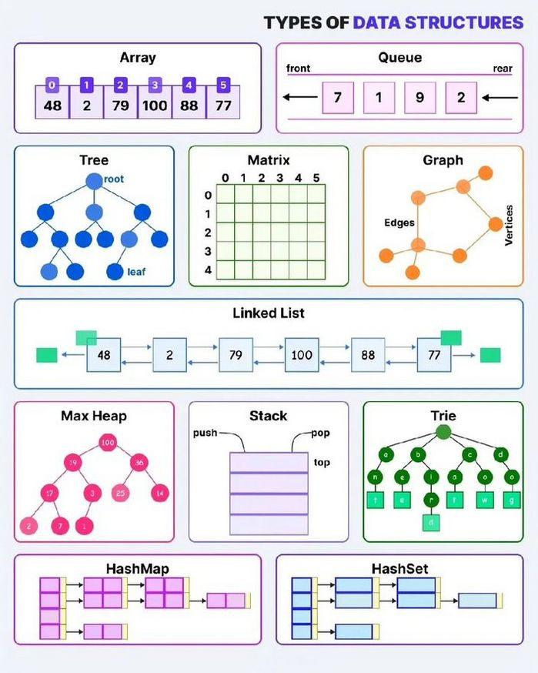
Data Structures

Slide 8
Data Structures

Slide 9
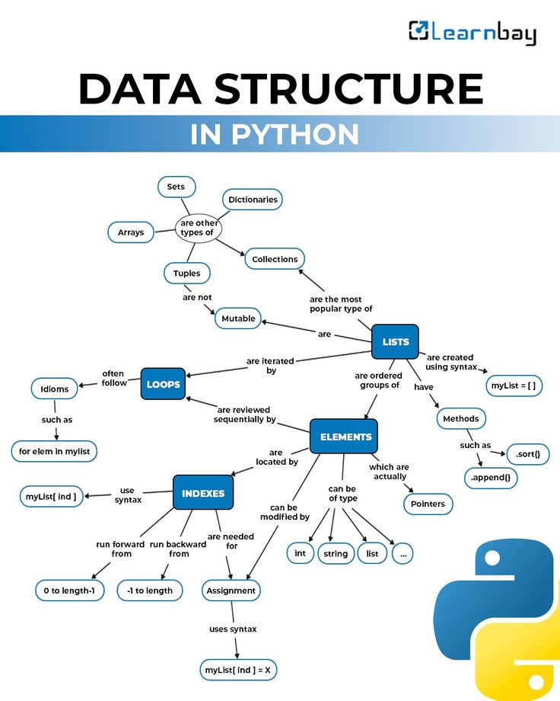
Data Structures in python?

Slide 10
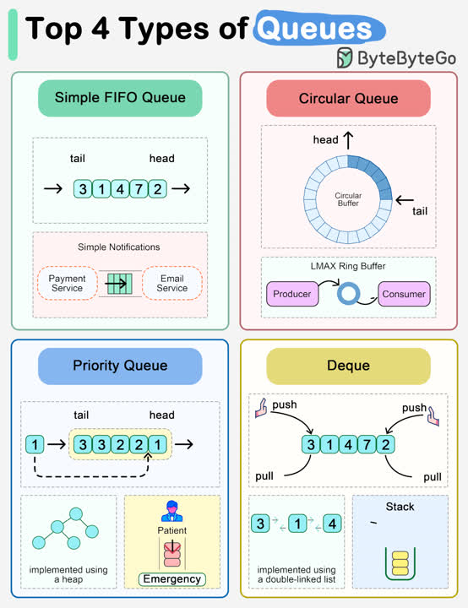
Queue?

Slide 11
Queue?

Slide 12
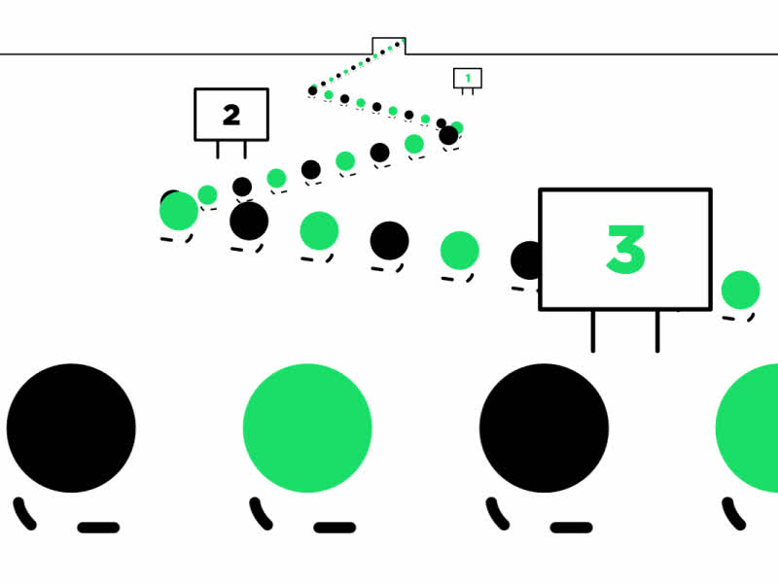
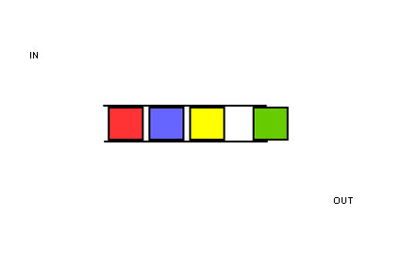
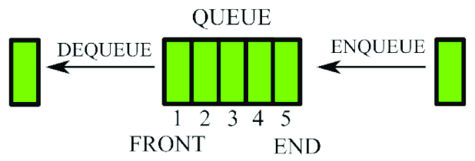
FIFO Concept ?

Slide 13
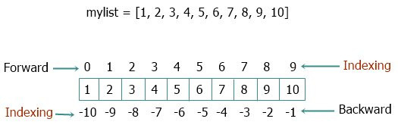
1st implementation :
implementing Queues with a Standard list
Standard list?

Slide 14
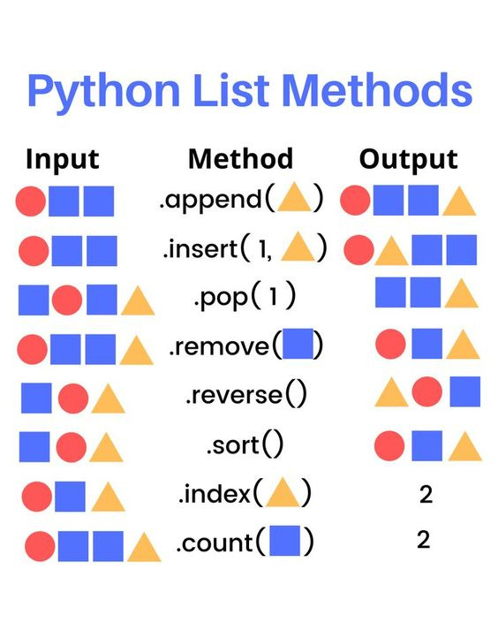

Slide 15
Standard List Methods from scratch:
ALGORITHM Append (F, x)
ALGORITHM Clear (F)
ALGORITHM Append (F, x):
2 INPUT
3 F: array of size n
4 x: element to add
5 BEGIN
6 F[size of F] ← x
7 END
ALGORITHM Clear (F):
2 INPUT
3 F: array of size n
4 BEGIN
5 FOR i FROM 0 TO size of F DO
6 F[i] ← NULL
7 END

Slide 16
ALGORITHM Remove (F, x)
ALGORITHM Reverse (F)
ALGORITHM Remove (F, x):
2 INPUT
3 F: array of size n
4 x: element to remove
5 BEGIN
6 index ← Index(F, x)
7 IF index ≠ -1 THEN
8 POP(F, index)
9 ELSE
10 DISPLAY "element not found"
11 END
ALGORITHM Reverse (F):
2 INPUT
3 F: array of size n
4 BEGIN
5 FOR i FROM 0 TO size of F / 2 DO
6 temp ← F[i]
7 F[i] ← F[size of F - 1 - i]
8 F[size of F - 1 - i] ← temp
9 END

Slide 17
ALGORITHM Copy (F)
ALGORITHM Count (F, x)
ALGORITHM Copy (F):
2 INPUT
3 F: array of size n
4 BEGIN
5 FOR i FROM 0 TO size of F DO
6 G[i] ← F[i] // G is a new array
7 END
8 RETURN G
ALGORITHM Count (F, x):
2 INPUT
3 F: array of size n
4 x: element to count
5 BEGIN
6 counter ← 0
7 FOR i FROM 0 TO size of F DO
8 IF F[i] = x THEN
9 counter ← counter + 1
10 END
11 RETURN counter
12 END

Slide 18
ALGORITHM Extend (F, G)
ALGORITHM Index (F, x)
ALGORITHM Extend (F, G):
2 INPUT
3 F: array of size n
4 G: array of size m
5 BEGIN
6 FOR i FROM 0 TO size of G DO
7 F[size of F + i] ← G[i]
8 END
ALGORITHM Index (F, x):
2 INPUT
3 F: array of size n
4 x: element to find
5 BEGIN
6 FOR i FROM 0 TO size of F DO
7 IF F[i] = x THEN
8 RETURN i
9 END
10 END
11 RETURN -1 // element not found
12 END

Slide 19
ALGORITHM Insert (F, i, x)
ALGORITHM Pop (F, i)
ALGORITHM Insert (F, i, x):
2 INPUT
3 F: array of size n
4 i: position to insert at
5 x: element to add
6 BEGIN
7 IF size of F = n OR i < 0 OR i > size of F THEN
8 DISPLAY "insertion error"
9 RETURN ERROR
10 ELSE
11 FOR j FROM size of F TO i DO
12 F[j] ← F[j - 1]
13 END
14 F[i] ← x
15 END
ALGORITHM Pop (F, i):
2 INPUT
3 F: array of size n
4 i: position to remove
5 BEGIN
6 IF i < 0 OR i >= size of F THEN
7 DISPLAY "index error"
8 RETURN ERROR
9 ELSE
10 x ← F[i]
11 FOR j FROM i TO size of F - 1 DO
12 F[j] ← F[j + 1]
13 END
14 RETURN x
15 END

Slide 20
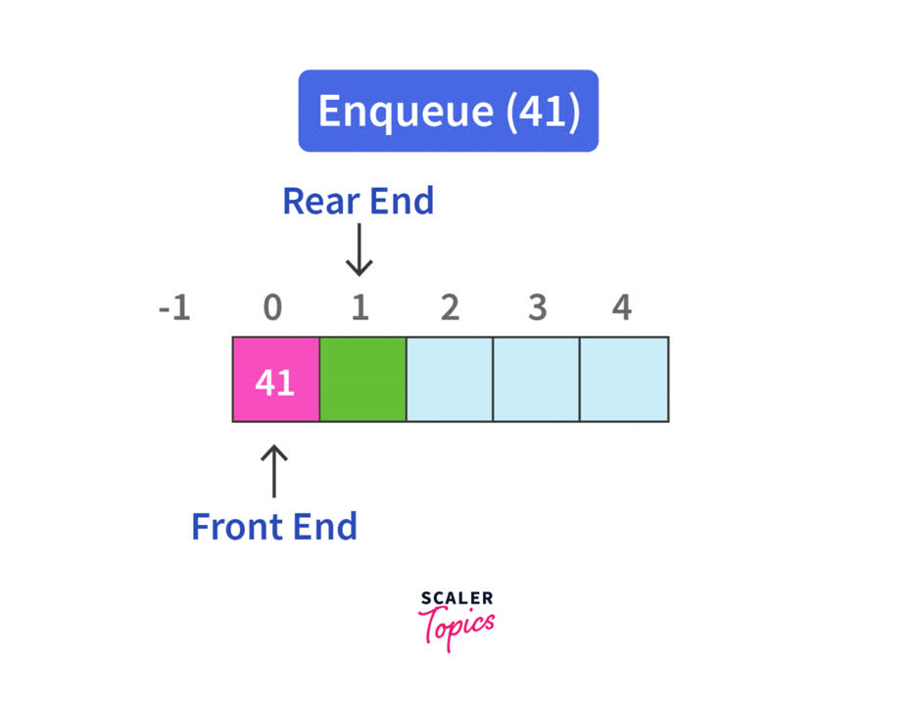
Manipulating a queue with a standard list :

Slide 21
Algorithms
ALGORITHM Enqueue (F, x)
ALGORITHM Dequeue (F, x)
ALGORITHM Enqueue (F, x):
2 INPUT
3 F: array of size n
4 x: element to add
5 BEGIN
6 IF size of F = n THEN
7 DISPLAY "overflow"
8 RETURN ERROR
9 ELSE
10 F[size of F] ← x
11 queue ← queue + 1
12 END
ALGORITHM Dequeue (F):
2 INPUT
3 F: array of size n
4 BEGIN
5 IF IsQueueEmpty(F) = FALSE THEN
6 head ← head + 1
7 RETURN F[head]
8 ELSE
9 DISPLAY "the queue is empty"
10 RETURN ERROR
11 END

Slide 22

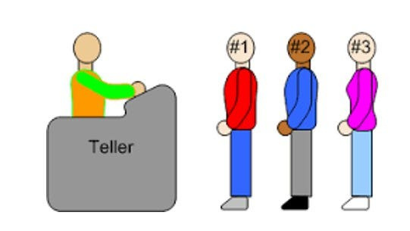
ALGORITHM IsQueueEmpty (F)
ALGORITHM IsQueueEmpty (F):
2 INPUT
3 F: array of size n
4 BEGIN
5 IF queue = 0 THEN
6 RETURN TRUE
7 ELSE
8 RETURN FALSE
9 END

Slide 23
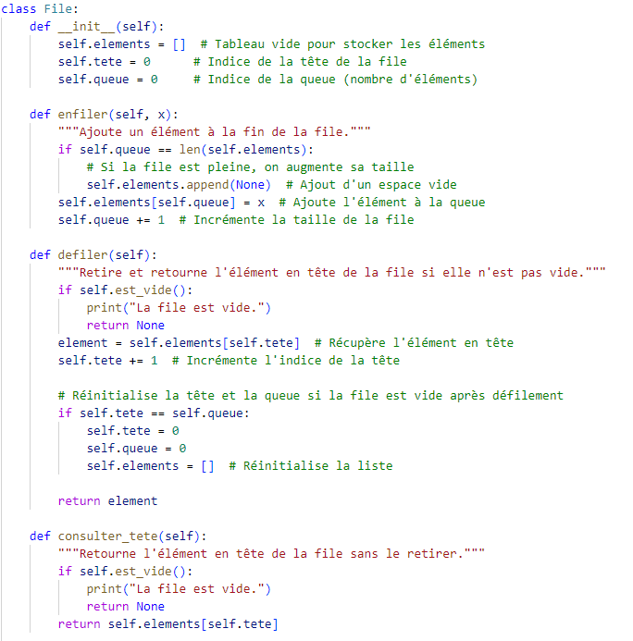
The code python from scratch (version 1):

Slide 24
The code python from scratch (version 1):

Slide 25
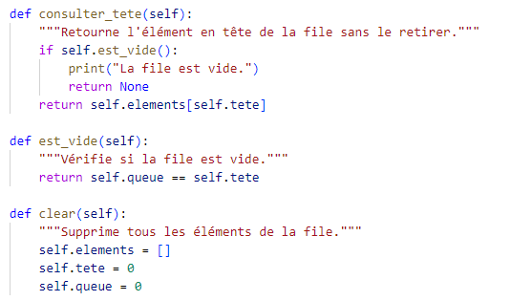
The code python from scratch (version 1):

Slide 26
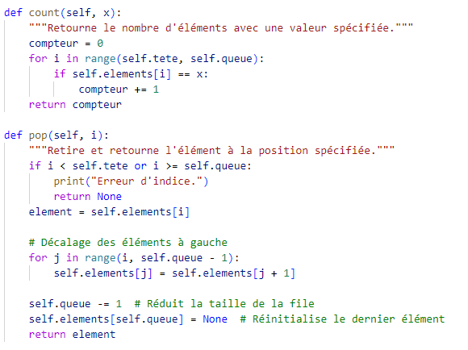
The code python from scratch (version 1):

Slide 27
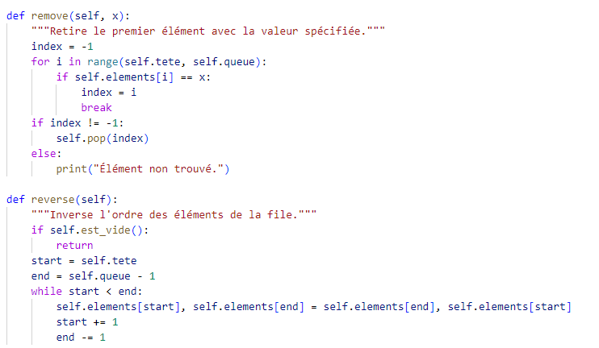
The code python from scratch (version 1):

Slide 28
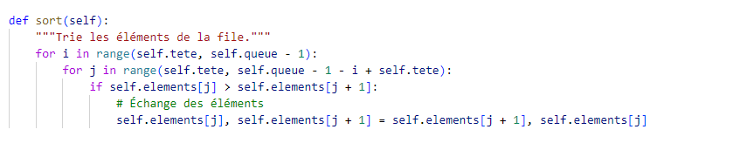
The code python from scratch (version 1):

Slide 29
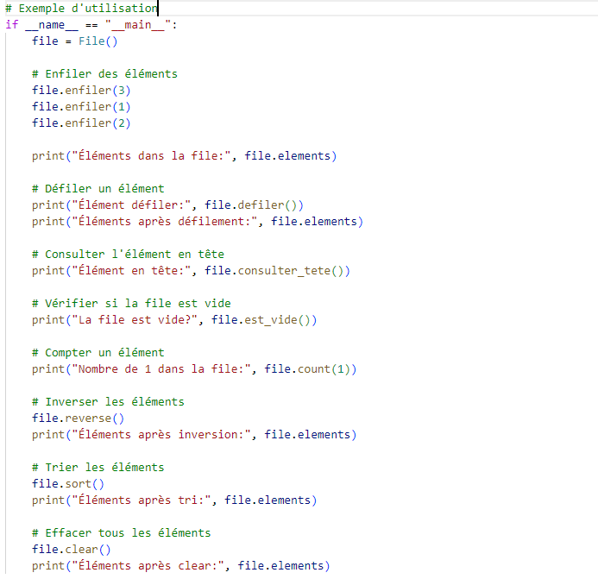
Main:

Slide 30
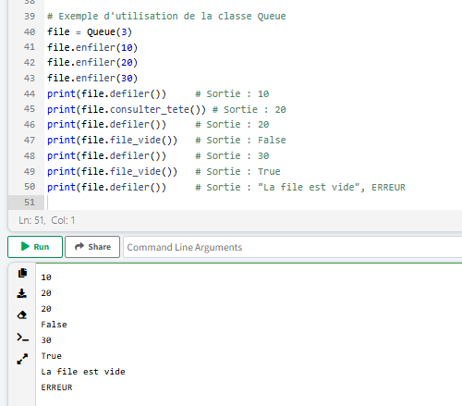
Result?

Slide 31
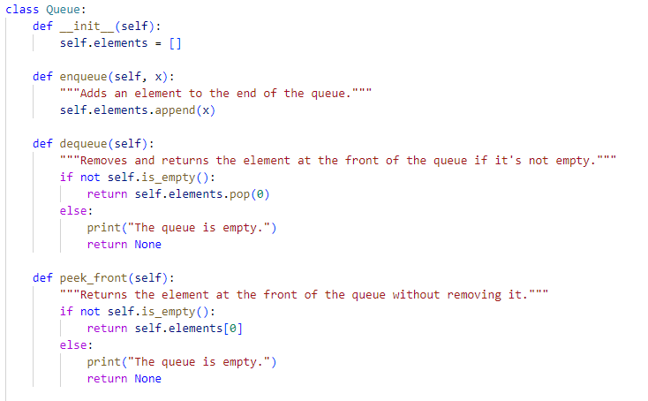
The code python using built-in methods (version 2):

Slide 32
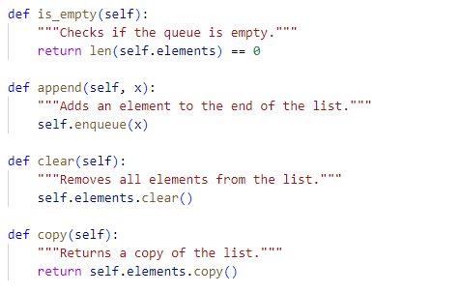

Slide 33
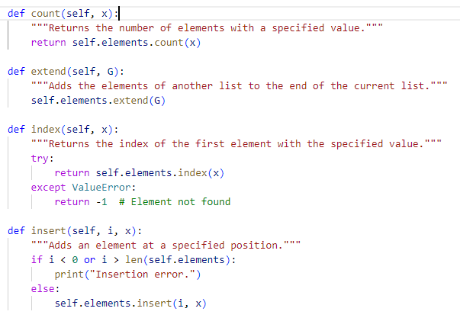

Slide 34
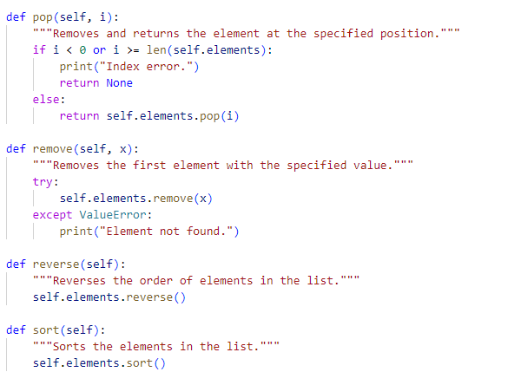

Slide 35
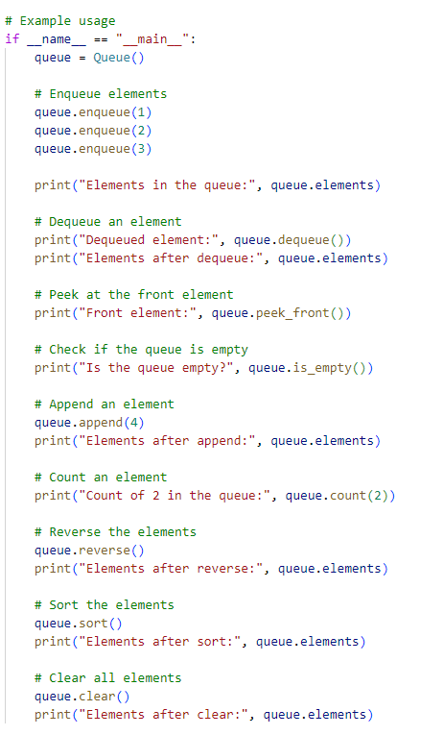
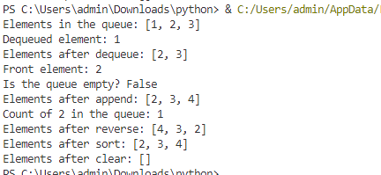
Main:
Result:

Slide 36
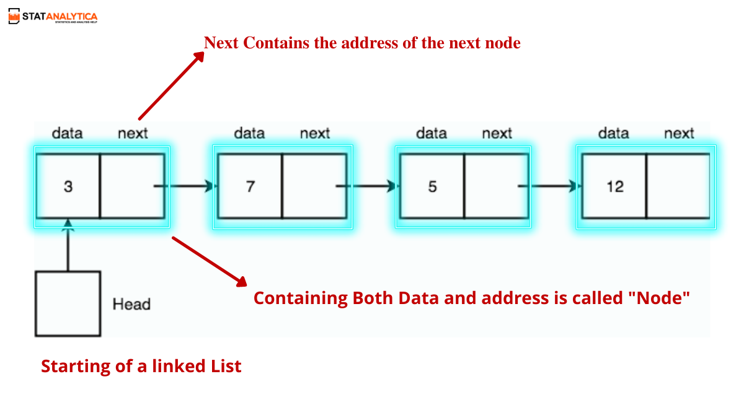
2st implementation :
implementing Queues with a Singly Linked list
Linked list?

Slide 37
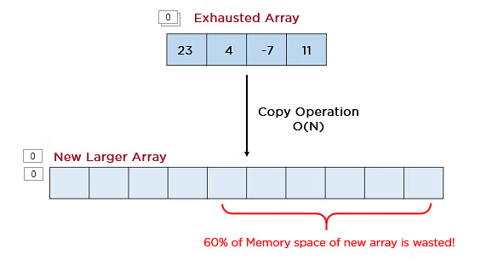
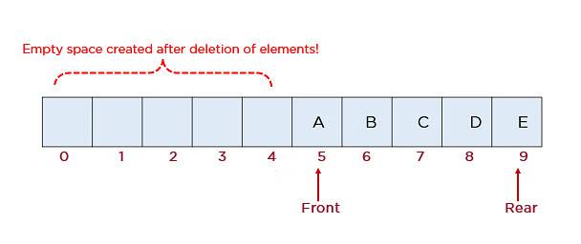
Why?

Slide 38
Singly Linked List Methods from scratch:
ALGORITHM Append (F, x)
ALGORITHM Clear (F)
function append(head, x):
// Step 1: Create a new node
newNode = allocate memory for Node
newNode.data = x
newNode.next = NULL
// Step 2: Check if the list is empty
if head == NULL:
head = newNode
return current = head
// Step 3: Traverse to the end of the list
while current.next != NULL:
current = current.next
// Step 4: Link the new node
current.next = newNode
function clear(head):
while head is not NULL:
temp = head
head = head.next
free(temp)
// Now, head is NULL, indicating an empty list

Slide 39
ALGORITHM Copy (head)
ALGORITHM Count (head , value)
function copy(head):
if head is NULL:
return NULL
new_head = allocate new node
new_head.data = head.data
new_head.next = NULL
current_original = head.next
current_new = new_head
while current_original is not NULL:
new_node = allocate new node
new_node.data = current_original.data
new_node.next = NULL
current_new.next = new_node
current_new = new_node
current_original = current_original.next
return new_head
function count(head, value):
count = 0
current = head
while current is not NULL:
if current.data == value:
count = count + 1
current = current.next
return count

Slide 40
ALGORITHM index(head, value)
ALGORITHM Sort (head)
function sort(head): sorted_list = NULL
current = head
while current is not NULL: next_node = current.next sorted_list = sorted_insert(sorted_list, current)
current = next_node
return sorted_list
function index(head, value):
position = 0
current = head
while current is not NULL:
if current.data == value:
return position
current = current.next
position = position + 1
return -1 // Value not found

Slide 41
function sorted_insert(sorted_list, new_node):
if sorted_list is NULL or sorted_list.data >= new_node.data:
new_node.next = sorted_list
sorted_list = new_node
else:
current = sorted_list
while current.next is not null and current.next.data < new_node.data:
current = current.next
new_node.next = current.next
current.next = new_node
return sorted_list

Slide 42
ALGORITHM extend(head1, head2
ALGORITHM pop(head)
function extend(head1, head2):
if head1 is NULL:
return head2
current = head1
while current.next is not NULL:
current = current.next
current.next = head2
return head1
function pop(head):
if head is NULL:
return NULL
if head.next is NULL:
data = head.data
free(head)
return NULL, data
current = head
while current.next.next is not NULL:
current = current.next
data = current.next.data
free(current.next)
current.next = NULL
return head, data

Slide 43
function sort(head):
sorted_list = NULL
current = head
while current is not NULL:
next_node = current.next
sorted_list = sorted_insert(sorted_list, current)
current = next_node
return sorted_list
ALGORITHM remove(head, value)
ALGORITHM insert(head, position, value)
function remove(head, value):
if head is NULL:
return NULL
if head.data == value:
temp = head
head = head.next
free(temp)
return head
current = head
while current.next is not NULL:
if current.next.data == value:
temp = current.next
current.next = current.next.next
free(temp)
return head
current = current.next
return head
function insert(head, position, value):
new_node = allocate new node
new_node.data = value
if position == 0:
new_node.next = head
return new_node
current = head
for i from 0 to position - 1:
if current is NULL:
// Position is out of bounds
free(new_node)
return head
current = current.next
new_node.next = current.next
current.next = new_node
return head

Slide 44
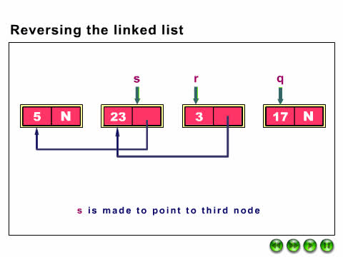
function sort(head):
sorted_list = NULL
current = head
while current is not NULL:
next_node = current.next
sorted_list = sorted_insert(sorted_list, current)
current = next_node
return sorted_list
ALGORITHM reverse(head)
function reverse(head):
previous = NULL
current = head
while current is not NULL:
next_node = current.next
current.next = previous
previous = current
current = next_node
head = previous
return head

Slide 45

Implementing Queues with a Singly Linked list
TYPE Node:
DATA
x : element
next : pointer to the next node
TYPE Queue:
DATA
head : Node (pointer to the first node)
tail : Node (pointer to the last node)
size : integer
ALGORITHM InitializeQueue():
BEGIN
Q.head ← NULL
Q.tail ← NULL
Q.size ← 0
END

Slide 46


ALGORITHM IsEmpty (Q)
ALGORITHM IsEmpty (Q):
2 DATA
3 Q : Queue
4 BEGIN
5 RETURN Q.head = NULL
6 END

Slide 47
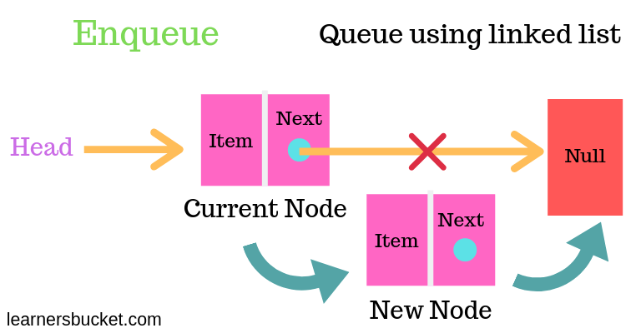

Slide 48
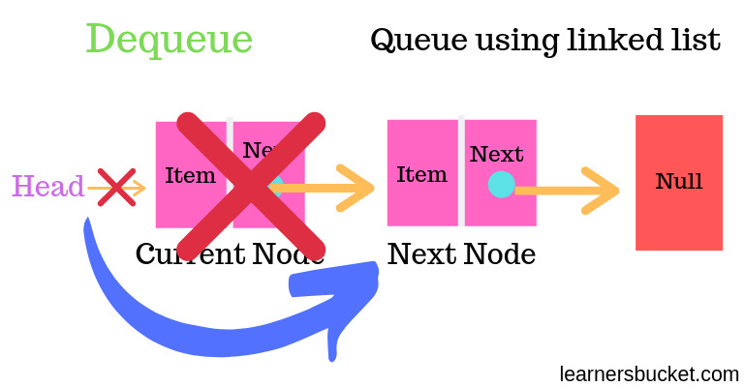

Slide 49
ALGORITHM Enqueue (Q, x)
ALGORITHM Dequeue (Q, x)
ALGORITHM Enqueue (Q, x):
2 DATA
3 Q : Queue
4 x : element to add
5 BEGIN
6 newNode ← create a new Node with x
7 IF Q.head = NULL THEN
8 Q.head ← newNode
9 Q.tail ← newNode
10 ELSE
11 Q.tail.next ← newNode
12 Q.tail ← newNode
13 END
14 Q.size ← Q.size + 1
15 END
ALGORITHM Dequeue (Q):
2 DATA
3 Q : Queue
4 BEGIN
5 IF Q.head = NULL THEN
6 DISPLAY "The queue is empty."
7 RETURN ERROR
8 ELSE
9 element ← Q.head.x
10 Q.head ← Q.head.next
11 IF Q.head = NULL THEN
12 Q.tail ← NULL
13 END
14 Q.size ← Q.size - 1
15 RETURN element
16 END

Slide 50
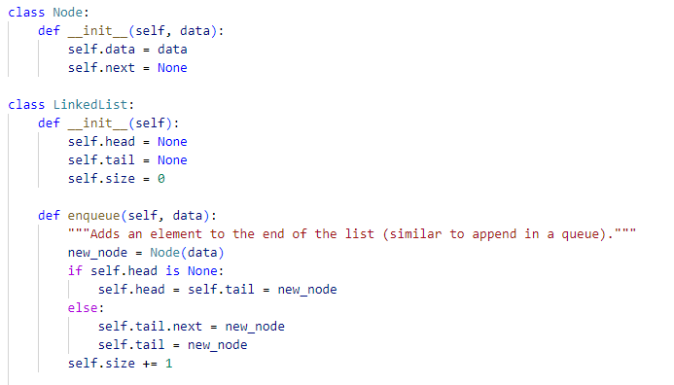
The code python from scratch (version 1):

Slide 51
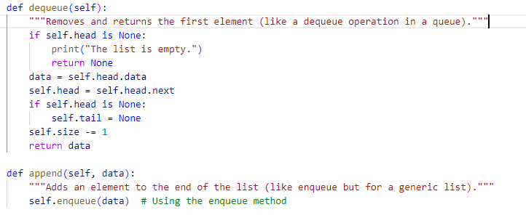

Slide 52
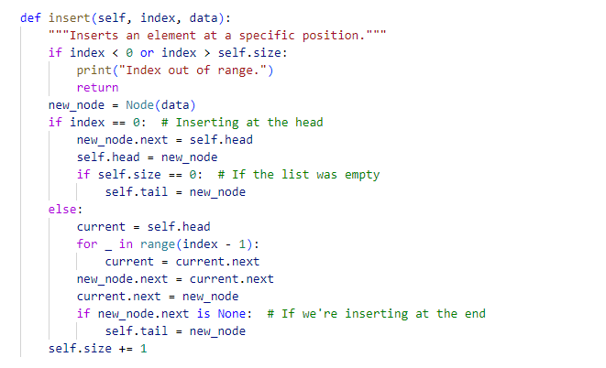

Slide 53
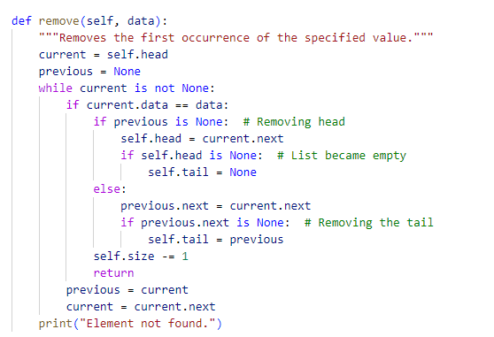

Slide 54
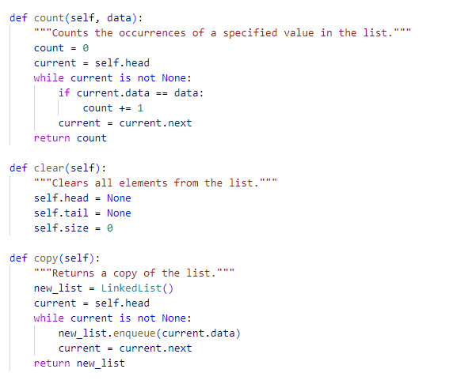

Slide 55
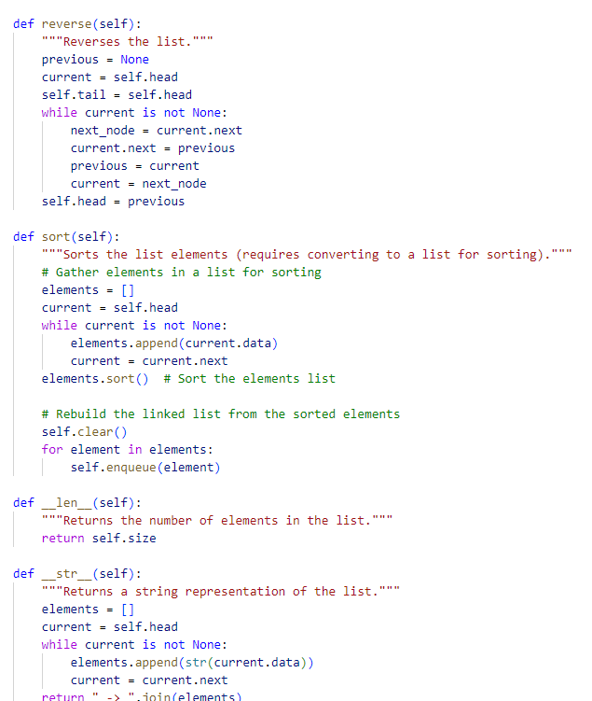

Slide 56
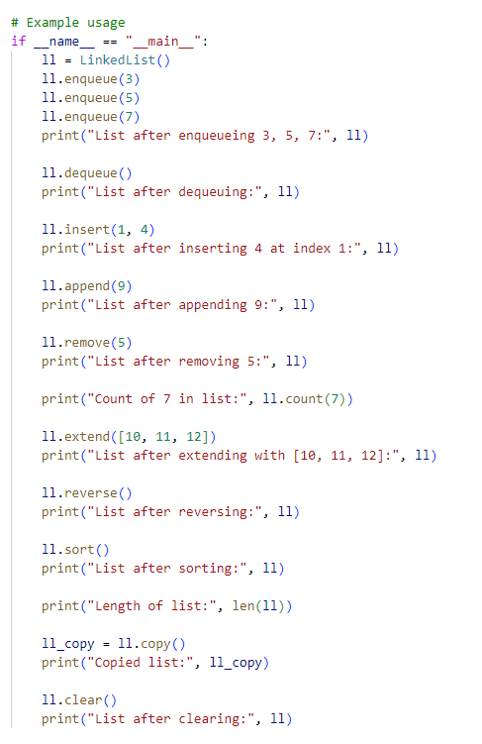
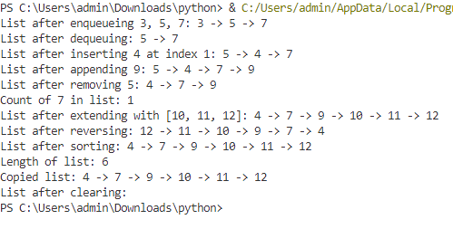

Slide 57
Version 2: Using deque from the collections module
from collections import deque
class LinkedList:
def __init__(self):
self.elements = deque()
def enqueue(self, data):
"""Adds an element to the end of the list (similar to append)."""
self.elements.append(data)
def dequeue(self):
"""Removes and returns the first element."""
if not self.elements:
print("The list is empty.")
return None
return self.elements.popleft()
def append(self, data):
"""Adds an element to the end of the list."""
self.elements.append(data)

Slide 58


Relation to AI:
Task Scheduling:
Search Algorithms
Event Handling
Relation to DS:
Message Passing
Load Balancing
Fault Tolerance

Slide 59
Conclusion

